Slide 1
Integrating hotspot measurements from Himawari-8 into the Sentinel bushfire monitoring system
Medhavy Thankappan and Lan-Wei Wang

Slide 2
Acknowledgments

Slide 3
Background
GA operates the Sentinel Hotspots national bushfire monitoring system
Data for hotspots in Sentinel are sourced from multiple satellites: AQUA, TERRA, NOAA-19 and SUOMI-NPP
Geoscience Australia received funding through the Australian Government’s National Emergency Management Projects Grants Programme to develop 10-minute Bushfire Hotspot Updates from Himawari-8 to be incorporated into the Sentinel system
Geoscience Australia signed an agreement with the University of Wisconsin for customising an existing hotspots algorithm (WFABBA) for application to Himawari-8
University of Wisconsin delivered a hotspots algorithm for Himawari-8 and associated documentation in May 2016; evaluation of algorithm performance is ongoing

Slide 4
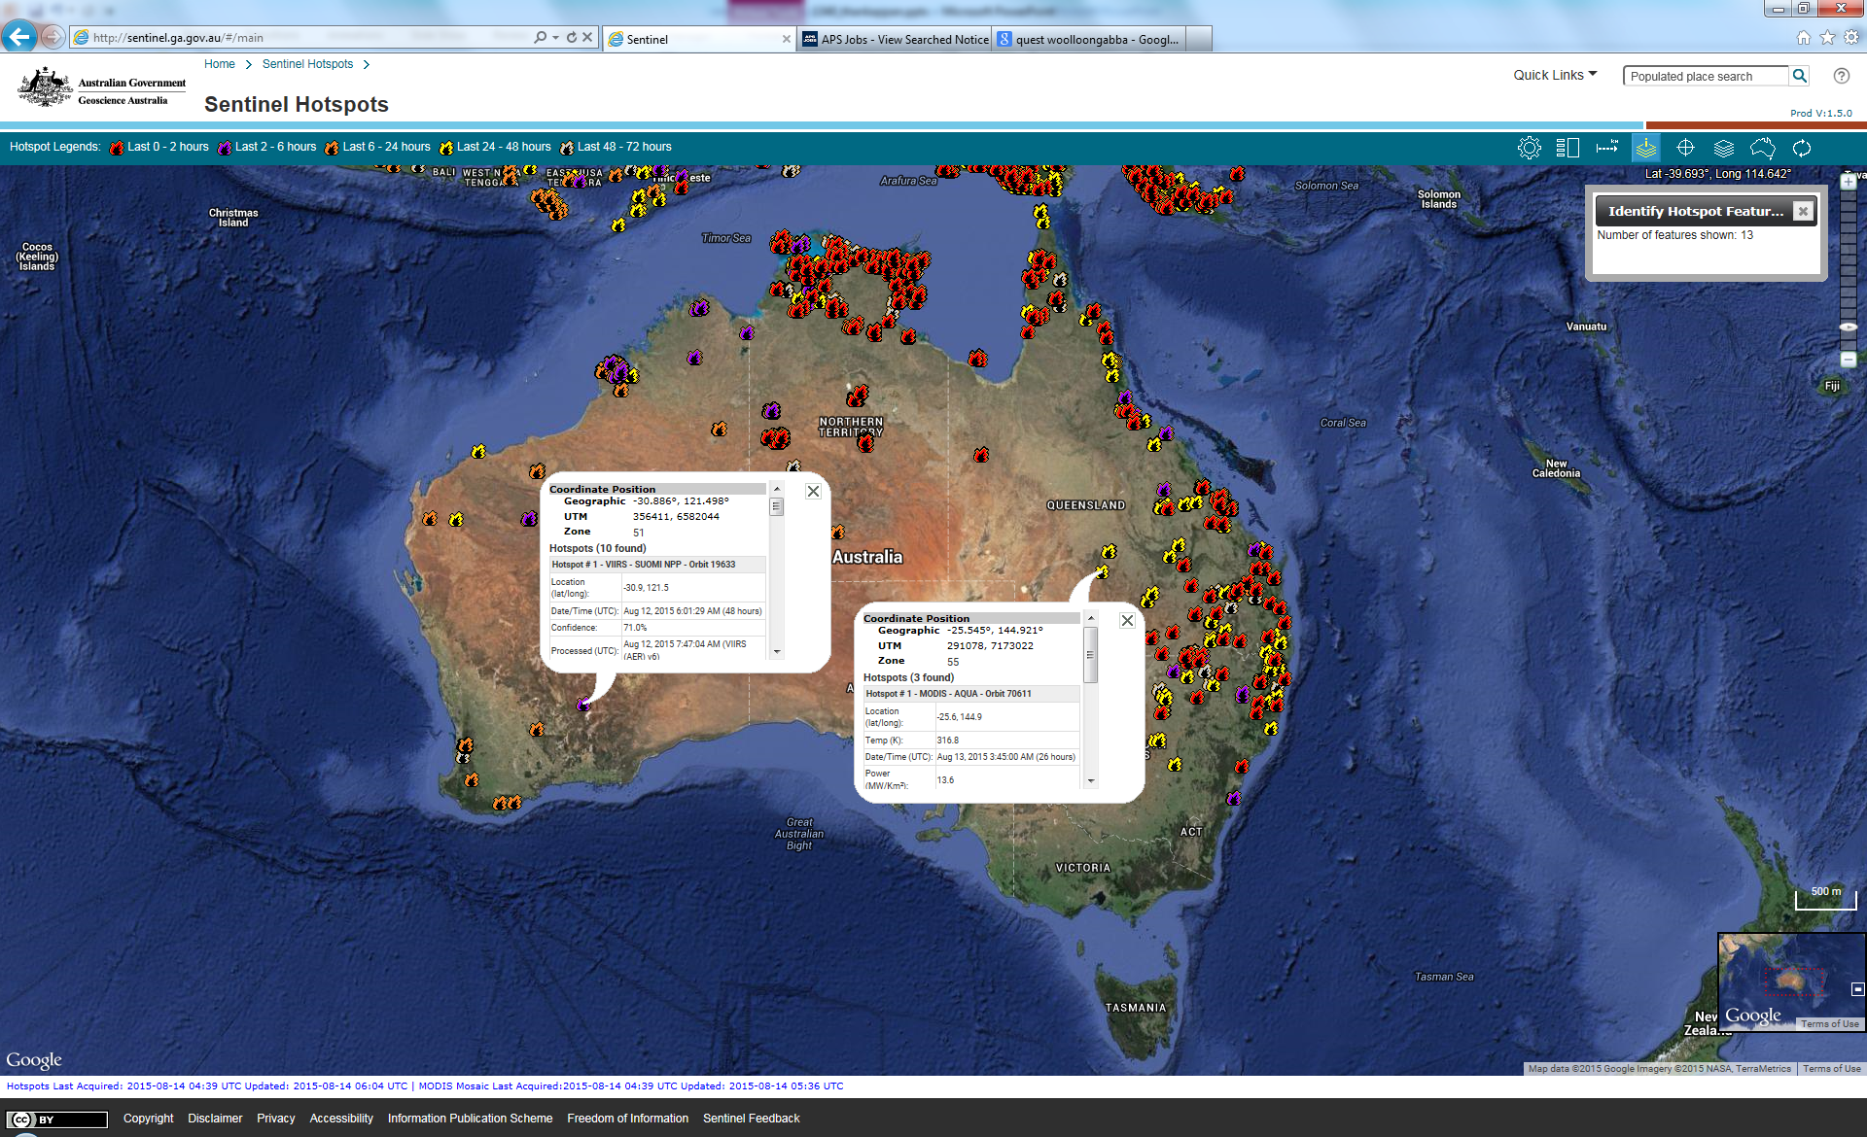
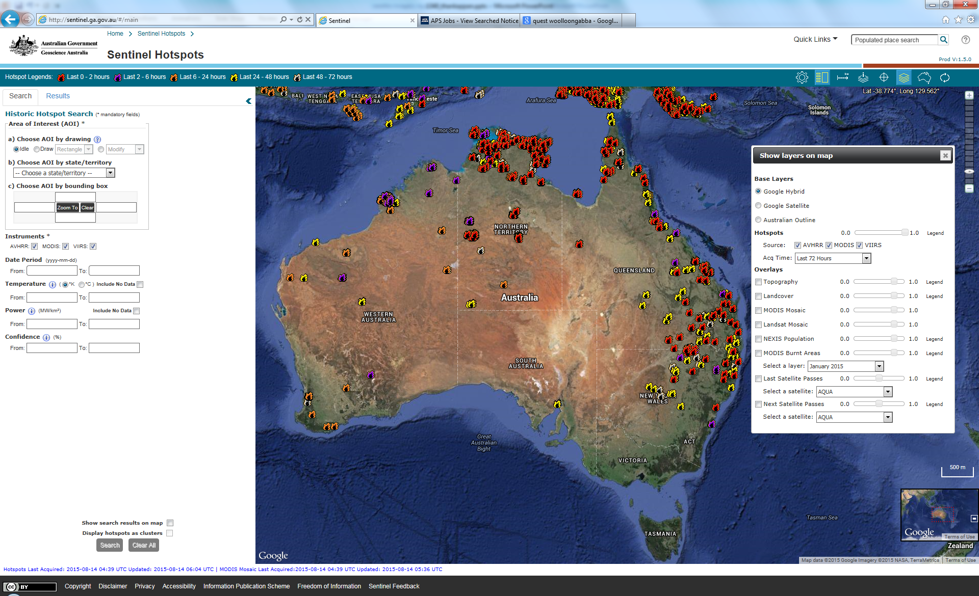
Sentinel Hotspots Monitoring System
Notes:
Sentinel Hotspots was initially a research project: (CSIRO, GA, BoM, Defence) 2003; operational in GA since 2005. New improved interface with familiar Google look and feel, users can interact through a number of query tools, and choose what is displayed. Base layers, hotspot sources or other contextual layers can be selected, Information on individual hotspots can be queried or historical hotspots searched, FTP site allows historical hotspots download.

Slide 5
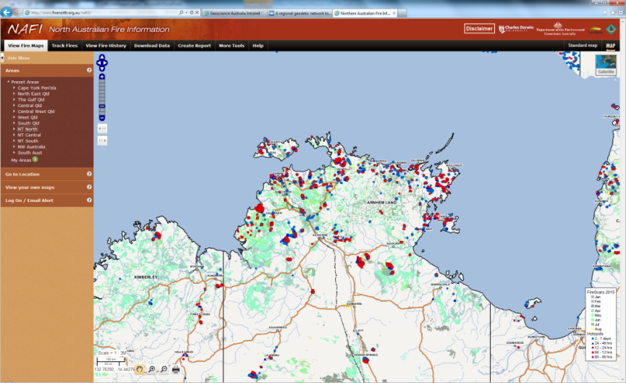
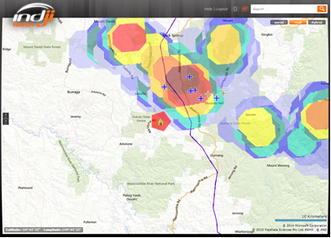
Sentinel hotspots applications
National-scale hotspots supports Federal Government information needs e.g. Crisis Coordination Centre
Particularly useful for fire related land management in remote areas e.g. North Australian Fire Information
Additional source for State based systems e.g. Emap- Victoria; redundancy for fire tower, air observations and community reports
Value-added hotspot products by private industry e.g. Indji Watch
Inclusion of Himawari-8 data would enable characterisation for active fires and pre- and post-fire monitoring applications
Notes:
Indji Watch graphic - it shows a hotspot near a line, but also a thunderstorm, so you can see the BoM radar and the lighting (crosses).
Most Sentinel traffic occurs during disaster season (November – March) and particularly during major bushfire events

Slide 6
Update on Himawari-8 hotspots
Himawari-8 hotspots algorithm was developed by University of Wisconsin, Madison by customising the Wildfire Automated Biomass Burning Algorithm (WFABBA) algorithm
The algorithm was deployed by the BoM to generate hotspots
Three periods were identified for testing performance:
2015 Oct 1 - 7
2016 Jan 2 - 15
2016 July 3 - 9
The processing time and hotspots accuracy of the algorithm have been evaluated
Notes:
WFABBA was developed at the Cooperative Institute for Meteorological Satellite Studies (CIMSS), as a cooperative effort between NOAA/NESDIS/STAR. In addition to fire detection location, WFABBA also provides instantaneous fire size and temperature and Fire Radiative Power (FRP).

Slide 7
Algorithm performance: processing time (BoM)
The Bureau of Meteorology provided information about the processing times for hotspots generation from multiple runs of algorithm on Himawari-8 data covering three different seasons.
Processing time results from two of the seasons is shown below:
2016 Jul 3 – 9 Winter
Number of run (every 10 mins) | gt 7 mins % | gt 10 mins % | gt 12 mins % | Max minutes
990 | 0 | 0 | 0 | 6
2016 Jan 2 – 15 Summer
Number of run (every 10 mins) | gt 7 mins % | gt 10 mins % | gt 12 mins % | Max minutes
1978 | 9.4 | 4.3 | 1.8 | 15

Slide 8
H-8 hotspots evaluation
Reference dataset: MODIS hotspots
H8 hotspot: only assessed hotspots in “saturated” and “processed” fire category (other classes: High, Medium, Low Possibility and Cloudy)
Omission error: for a given MODIS hotspot, there is no corresponding H8 hotspot within a 5-km search range
Commission error: for a given H8 hotspot, there is no corresponding MODIS hotspot within a 5-km search range
Testing period | Number of MODIS hotspots | Number of MODIS hotspot s matching H-8 hotspots | Number of MODIS hotspot not matching H-8 hotspots | Omission error | Number of H-8 hotspots | Number of H8 hotspots matching MODIS hotspots | Number of H8 hotspots not matching MODIS hotspots | Commission error
2015 Oct 01 ~ 07 | 7672 | 1512 | 6160 | 80.3% | 1256 | 932 | 324 | 25.8%
2016 Jan 02 ~ 15 | 2902 | 634 | 2268 | 78.2% | 553 | 318 | 235 | 42.5%
2016 Jul 03 ~ 09 | 5004 | 1451 | 3553 | 71% | 2168 | 1243 | 925 | 42.7%
Overall, most commission errors occurred in day time passes; night time passes showed very good match with MODIS hotspots
For Jan 2016, there are many H-8 hotspot commission errors (false positives) in the Northern Territory (NT), this may be due to the higher summer background temperature

Slide 9
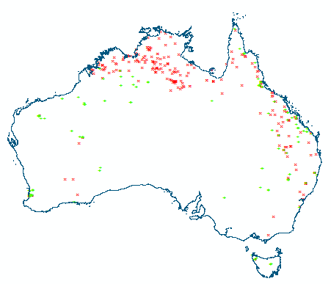
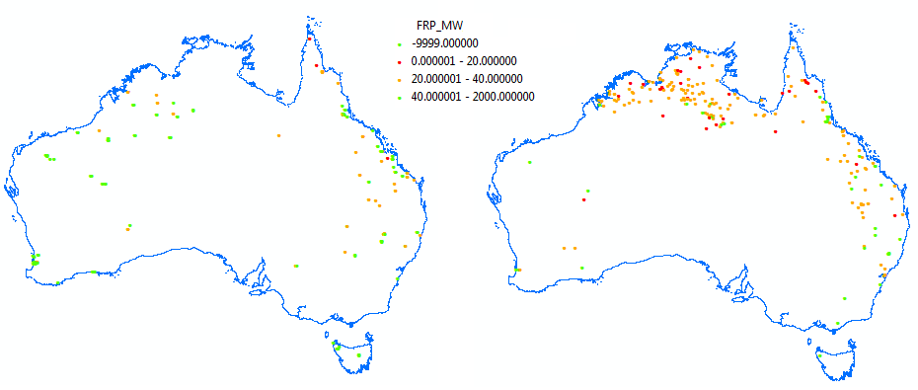
Commission error - January
2016 Jan 2-15 (318 matched hotspots shown in green colour, 235 no-matched hotspot shown in red colour)
If we visualise colour coded Fire Radiative Power (FRP) for the matched hotspots (left) and no-match hotspots (right), it appears that most of the no-match hotspots have lower FRP. Potential for FRP to be used for assessing the confidence of the H8 hotspots

Slide 10
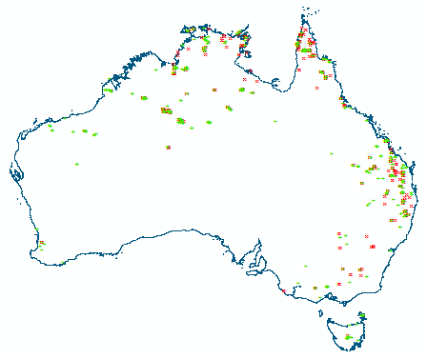
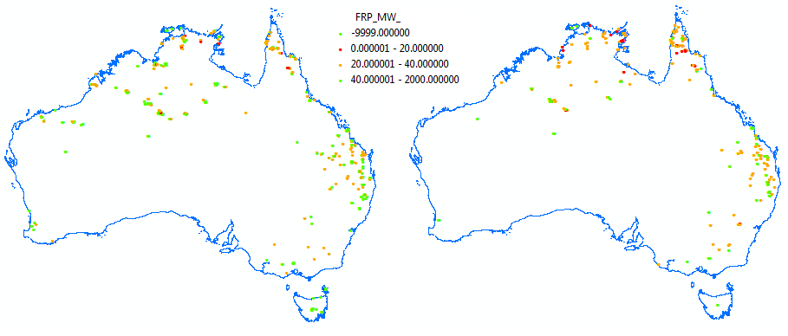
Commission error - July
2016 Jul 3-9 (1243 matched hotspots shown in green colour, 925 no-matched hotspot shown in red colour):
If we visualise colour coded Fire Radiative Power (FRP) for the matched hotspots (left) and no-match hotspots (right), it appears that most of the no-match hotspots have lower FRP. Potential for FRP to be used for assessing the confidence of the H8 hotspots
Notes:
GA will release a Himawari-8 hotspot feed on the secure site only for the 2016/17 fire season. Following a review by the Earth Observation science team of the validation process and results, it was recommended that the service be published but with caveats and labelled “Experimental”. While the data feed a lower accuracy than other datasets on Sentinel hotspots, it was decided that emergency managers are best placed to determine whether to include the data source in their decision making.

Slide 11
Summary
The WFABBA algorithm was customised by University of Wisconsin for use with Himawari-8 data
The BoM implemented the algorithm to extract hotspots from the H-8 data
Algorithm processing time and the hotspots from three sets of data from different periods was evaluated using MODIS hotspots as reference
Most commission errors occurred in day time passes; night time passes showed good match with MODIS hotspots
Many H-8 hotspot commission errors (false positives) in the Northern Territory were seen in the January data
H-8 Hotspots that did not match with MODIS hotspots seem to have a low FRP

Slide 12
Thank you
medhavy.thankappan@ga.gov.au
2nd GEO-LEO Applications Workshop, Tokyo, 1-2 September 2016

